Slide 1


Slide 2
Group Members
Yashobanta Nayak
Geetanjali
Shivpratap Patil
Ashwini
5) Priyanka
6) Tejaswini
7) Akshita
8) Rushikesh Raykar

Slide 3
Introduction
Olist is a Brazilian e-commerce marketplace connecting sellers and customers across the country.
Dataset contains order, customer, product, seller, payment and review information.
Objective: Gain insights on customer behavior, sales trends, delivery performance & business growth opportunities.

Slide 4
Project Objective
Understand factors affecting customer satisfaction and delivery performance.
Identify top-performing products and sellers.
Analyze payment preferences and revenue trends.
Develop actionable recommendations for business improvement.
Overview
Key tables used:
    Orders Dataset
    Customers Dataset
    Sellers Dataset
    Payments Dataset
    Reviews Dataset
    Order Items & Products

Slide 5
KPI List
Weekday Vs Weekend (order_purchase_timestamp) Payment Statistics
Number of Orders with review score 5 and payment type as credit card.
Average number of days taken for order_delivered_customer_date for pet_shop
Average price and payment values from customers of sao paulo city
Relationship between shipping days (order_delivered_customer_date - order_purchase_timestamp) Vs review scores.

Slide 6
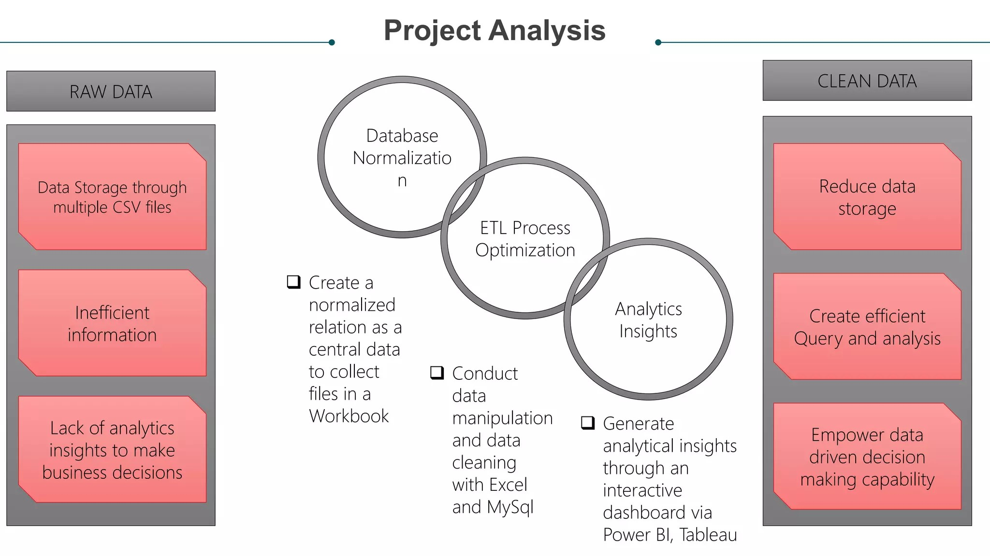

Slide 7
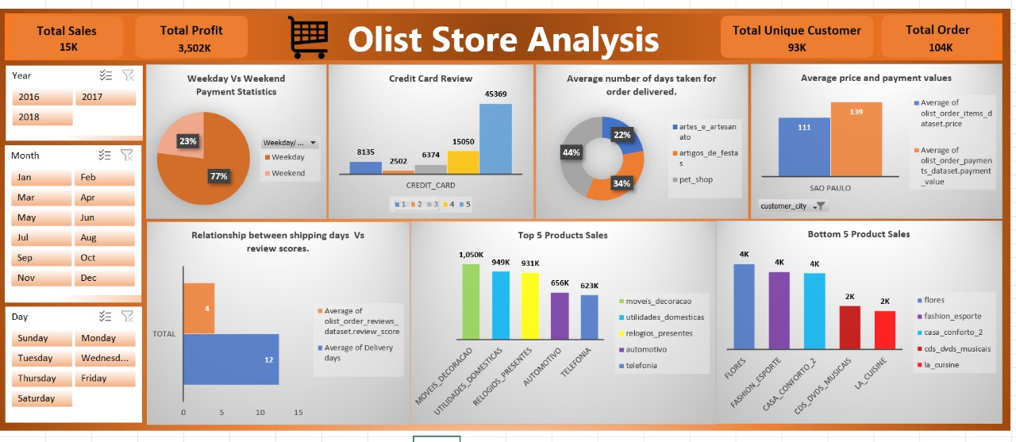
Excel Dashboard

Slide 8
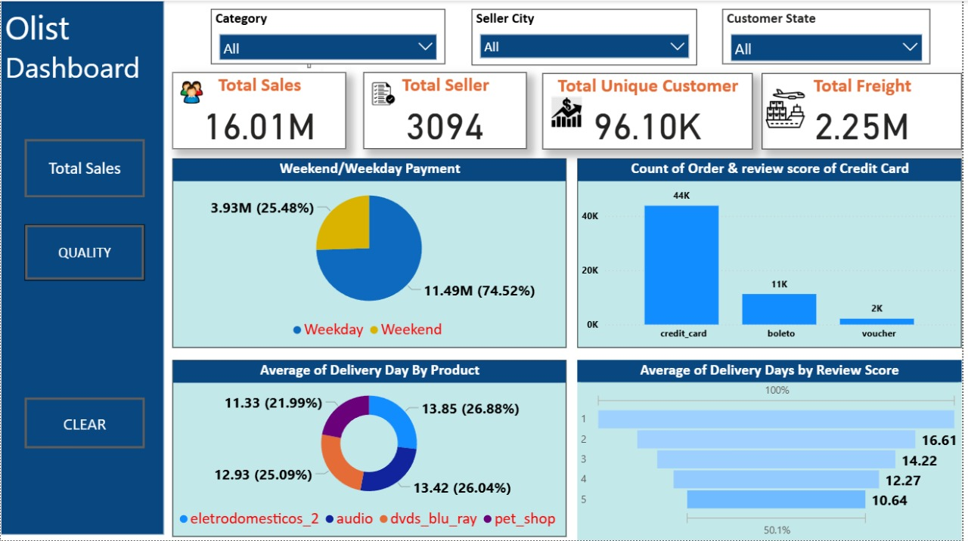
Power BI Dashboard

Slide 9
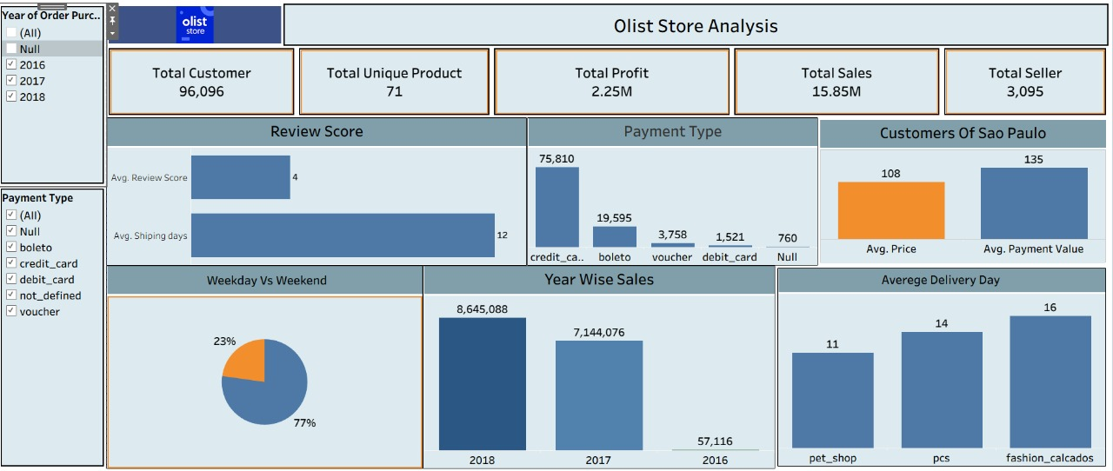
Tableau Dashboard

Slide 10
Difficulties Faced In SQL
Query Optimization: Writing efficient JOIN operations across multiple tables , implementing nested subqueries for complex filtering and creating accurate aggregation functions required careful planning and multiple iterations to avoid performance issues.
Error management: Frequent errors due to inconsistent column naming conversations, extra spaces in field names, and case sensitivity issues that caused queries to fail required systematic debugging approaches.
Data Transfer Challenges: Converting Excel Sheets to SQL compatible formats, handling different data types during import, and maintaining data integrating throughout the transfer process posed significant technical challenges.

Slide 11
Key Insights :-
Credit Card is the most used payment method
Majority of reviews are positive (score 5), but delays affect low ratings
Delivery time is a major factor influencing reviews
Electronics & home goods categories generate highest revenue
Weekdays have more orders compared to weekends

Slide 12
Business Recommendations :-
Improve logistics network to reduce delivery delays.
Promote top-selling categories and bundle slow-moving products.
Introduce offers on debit card / boleto to diversify payment usage.
Enhance customer support to reduce negative reviews.
Use targeted marketing based on region & product popularity.

Slide 13
Conclusion :-
Olist dataset provides deep insights into customer behavior, product performance & delivery operations.
Data-driven decisions can improve customer satisfaction, operational efficiency & business profitability.
E-commerce success depends on faster delivery, better product variety & improved service quality.

Slide 14
Thank
You

